Slide 1
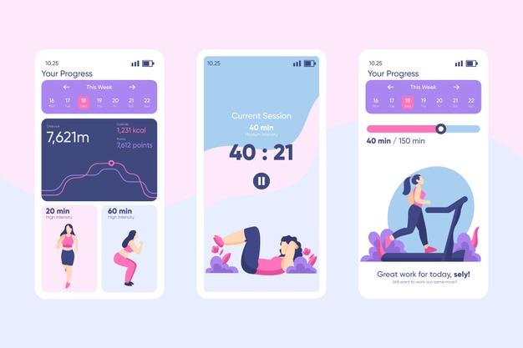
Health & Fitness Tracking App

Slide 2
Project purpose & Dataset
Understand what factors drive calorie burn.
Identify key user characteristics that influence fitness performance
Dataset Overview:
The dataset contains 54 features related to fitness, health, and workout performance.
Includes:
Demographics: Age, Gender, Weight, Height
Physiological metrics: Max BPM, Avg BPM, Resting BPM
Workout details: Duration, Workout Type (HIIT, Cardio, Strength)
Nutrition data: macros, calorie intake, protein per kg
Body composition: BMI, Lean Mass
Calculated metrics: expected burn, calorie balance
Calorie Burn Category (Low, Medium, High)

Slide 3
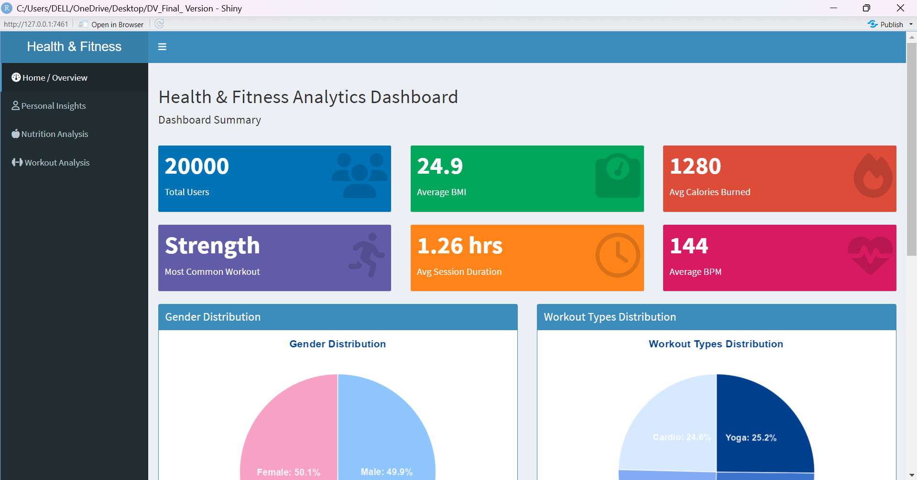
GUI Design

Slide 4
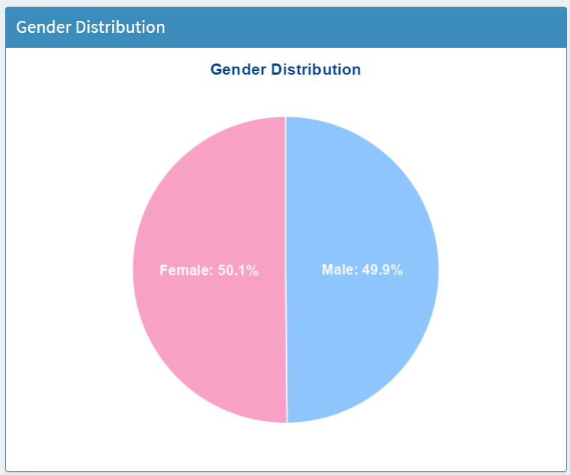
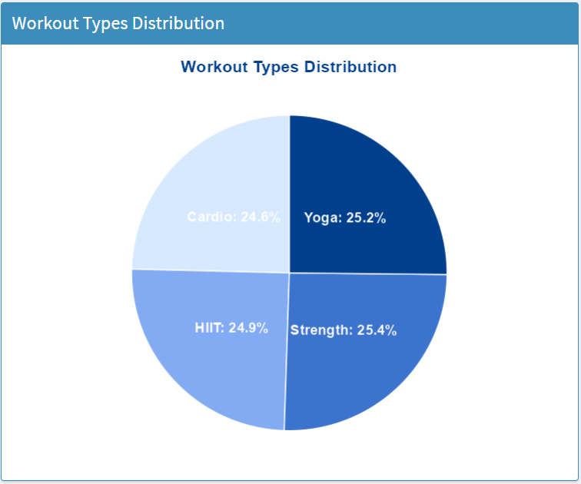
Data visualization
Home/Overview tab :

Slide 5
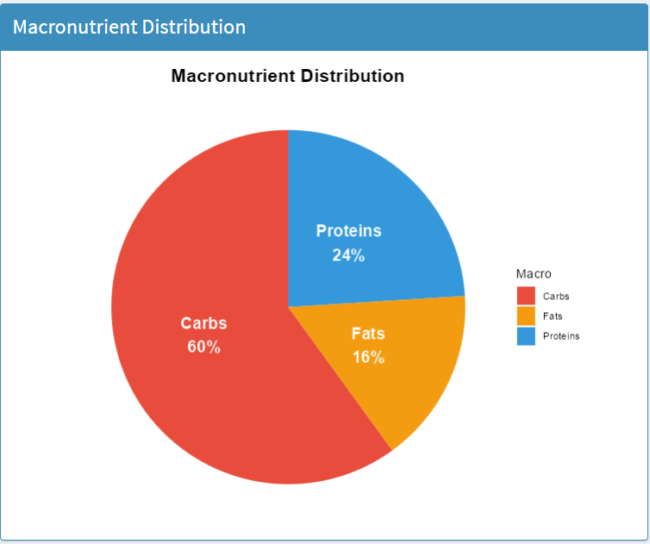
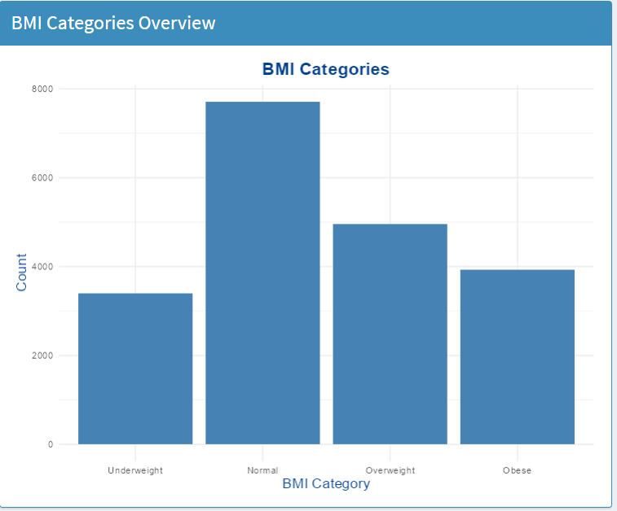
Data visualization
Home/Overview tab :

Slide 6
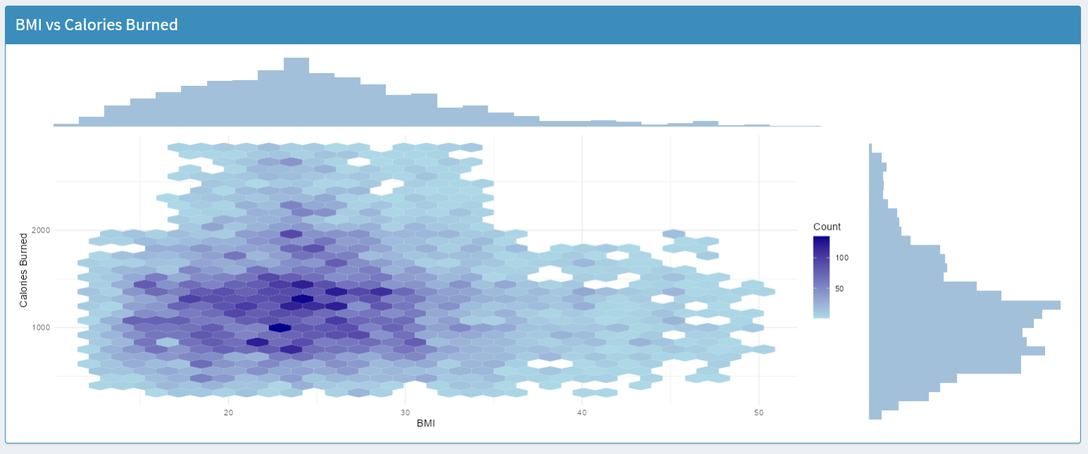
Data visualization
Personal insights tab : The Personal Insights tab explores how users physical characteristics influence workout performance.

Slide 7
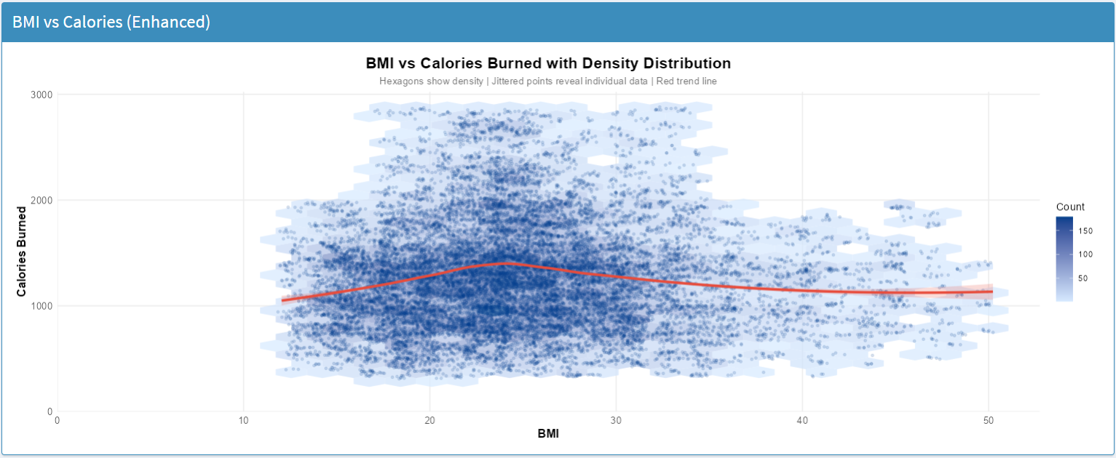
Data visualization
Personal insights tab :

Slide 8
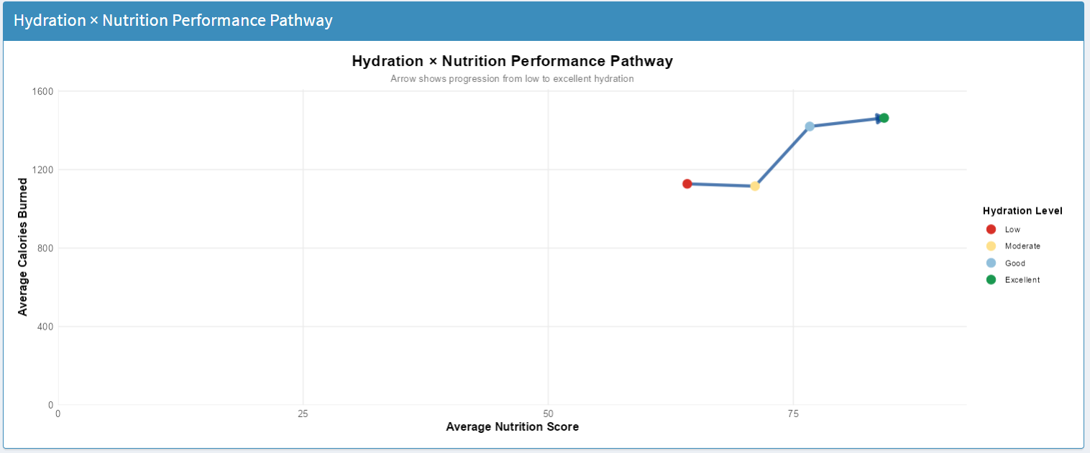
Data visualization
Nutrition Analysis tab : we focused on how hydration, macronutrient balance, and overall nutrition quality affect calorie burn and training performance. I’ll briefly walk through the three visualizations

Slide 9
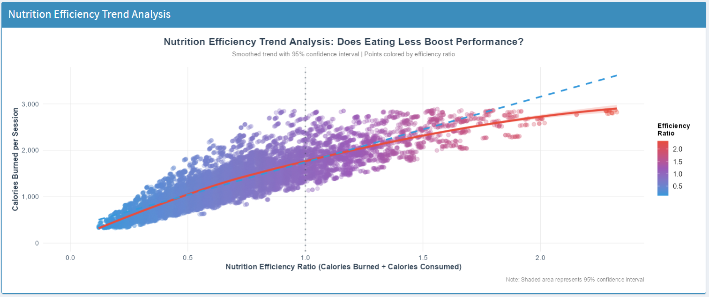
Data visualization
Nutrition Analysis tab :

Slide 10
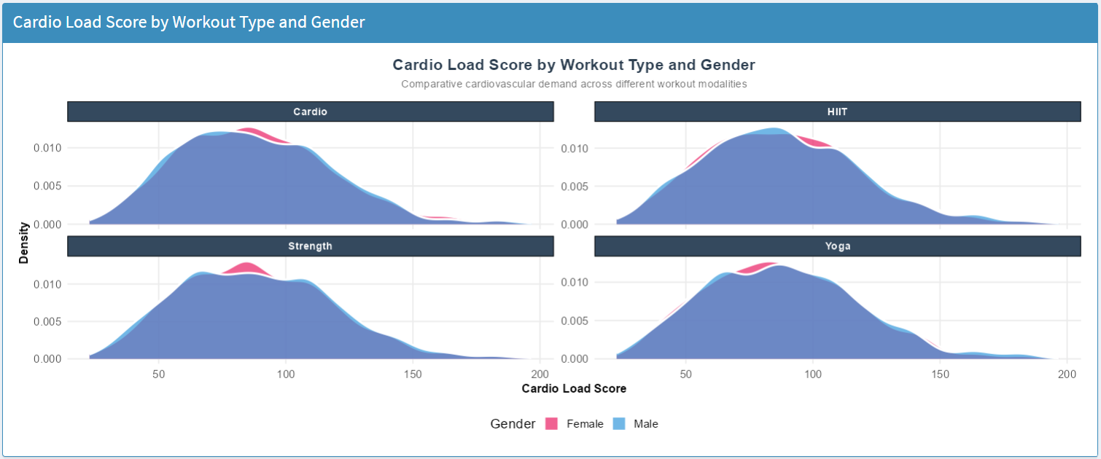
Data visualization
Workout Analysis tab :

Slide 11
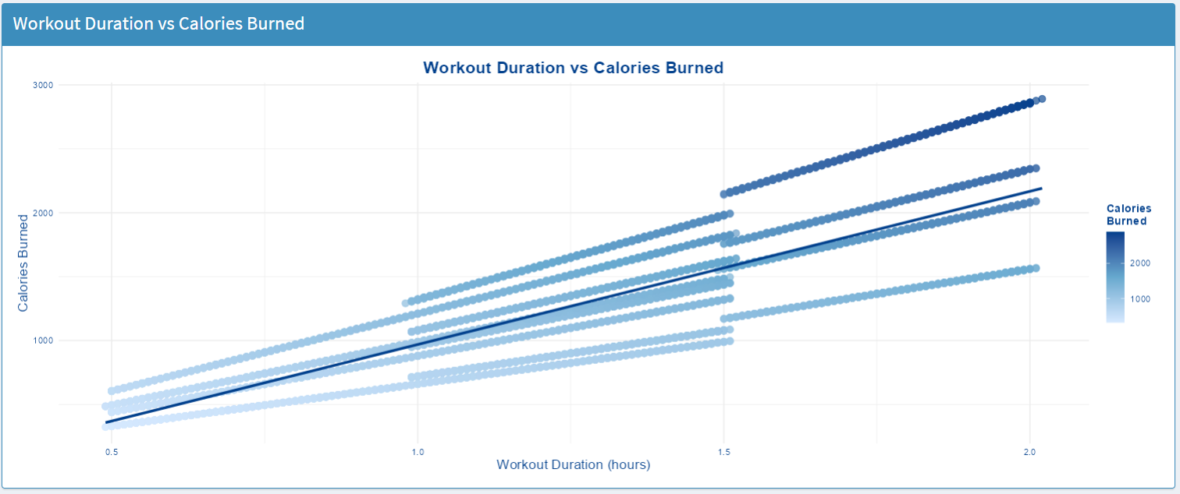
Data visualization
Workout Analysis tab :

Slide 12
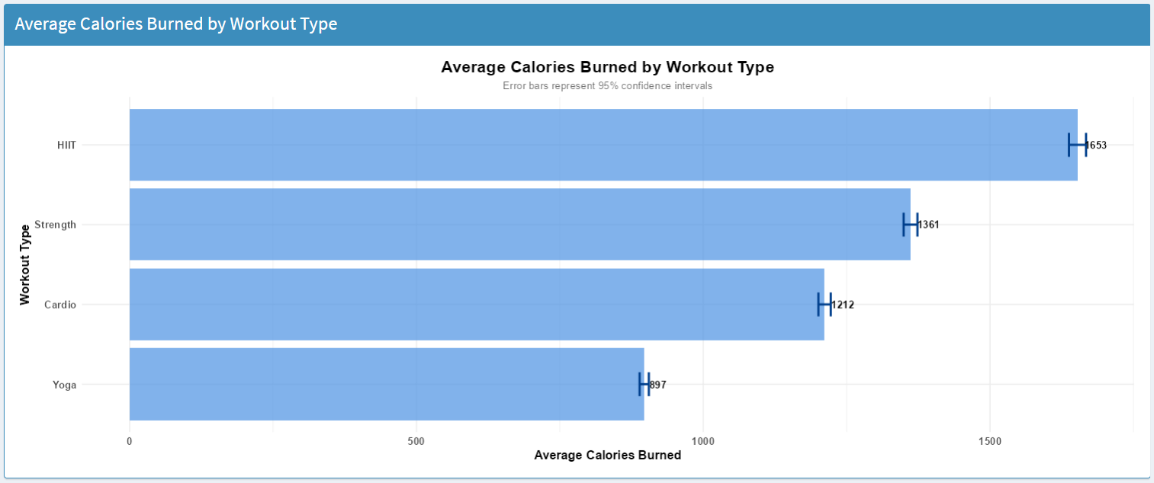
Data visualization
Workout Analysis tab :

Slide 13
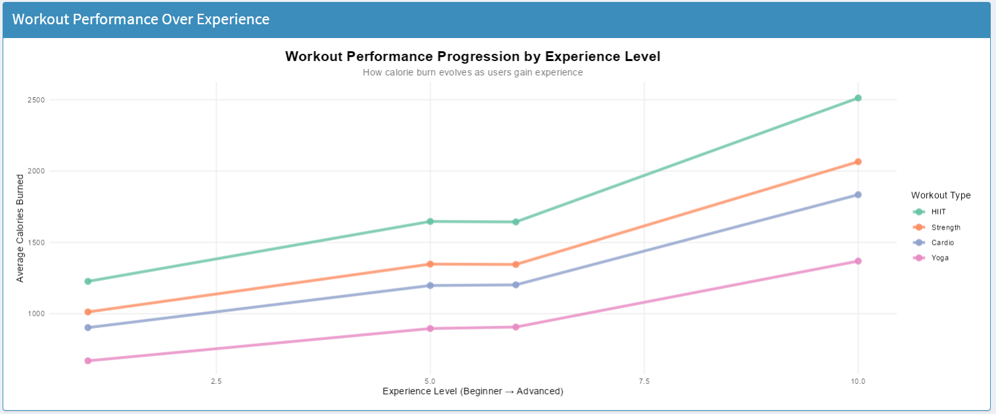
Data visualization
Workout Analysis tab :

Slide 14
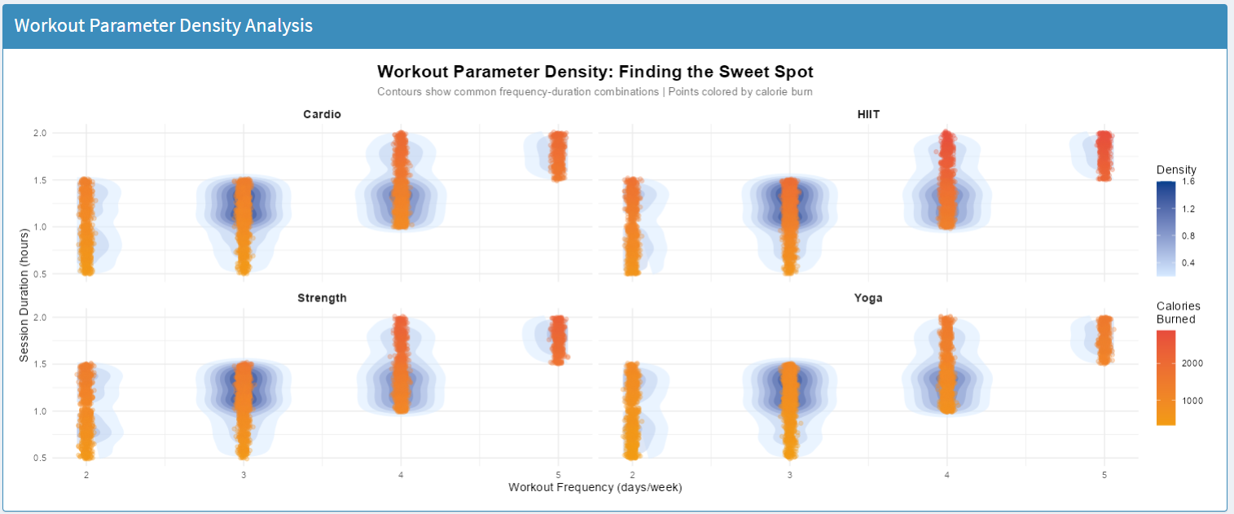
Data visualization
Workout Analysis tab :

